Slide 1


BOSTON-IS IT SAFE?
Submitted by:
SHRADDHA THAKKAR

Slide 2


Slide 3
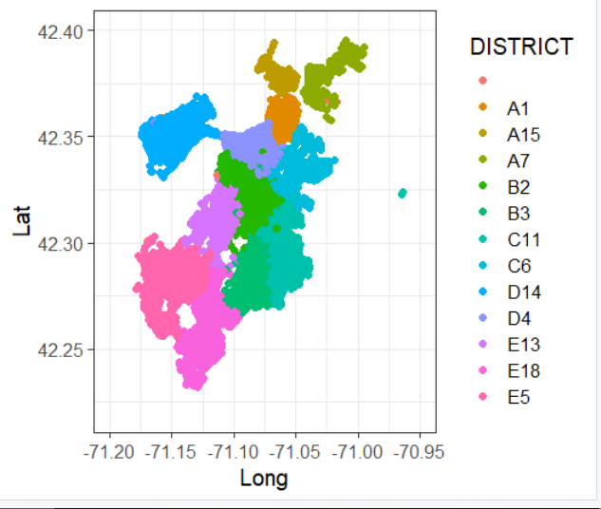
---> The overall crime rate in Boston is equal to the national average.
--->For every 100,000 people, there are 7.56 daily crimes that occur in boston.
--->Boston is safer than 14% of the cities in the United States.
--->In boston you have a 1 in 37 chance of becoming a victim of any crime.
--->Here we can see respective areas (districts) of boston crimes.

Slide 4
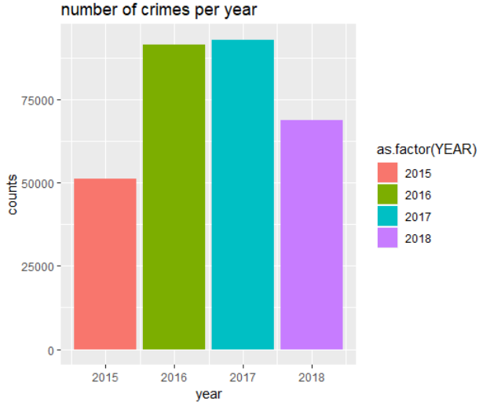
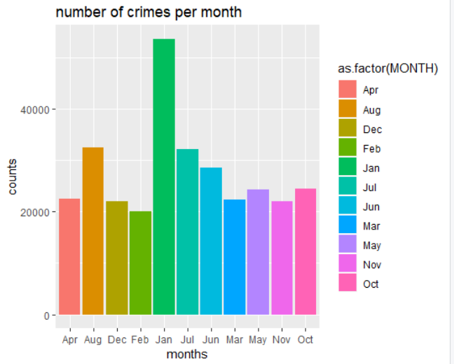

Slide 5
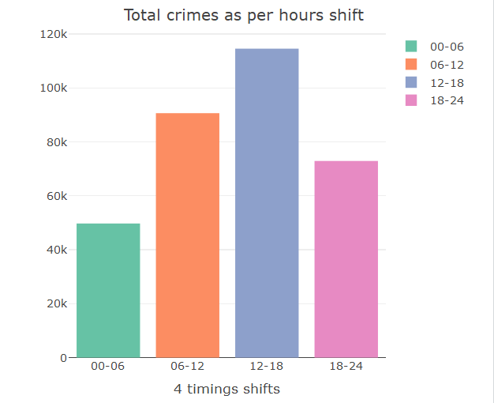

Slide 6
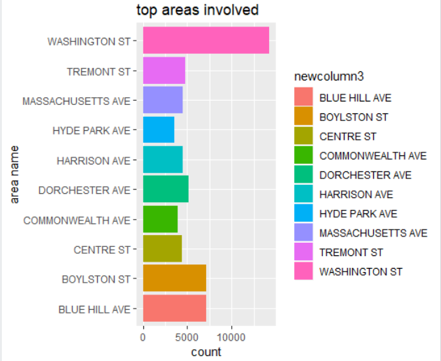

Slide 7
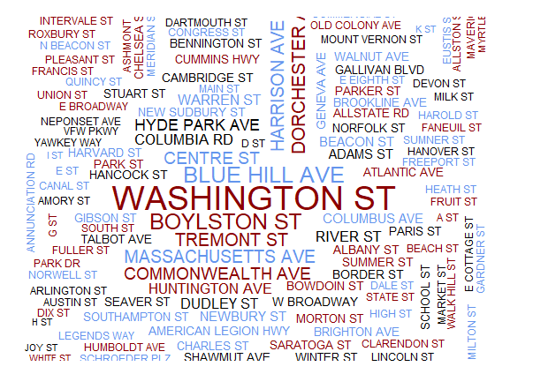

Slide 8
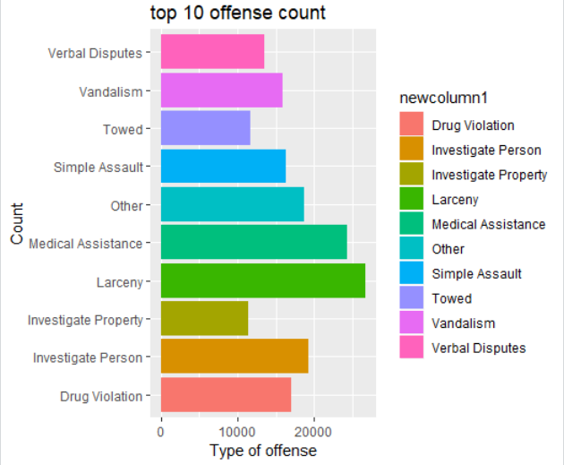

Slide 9
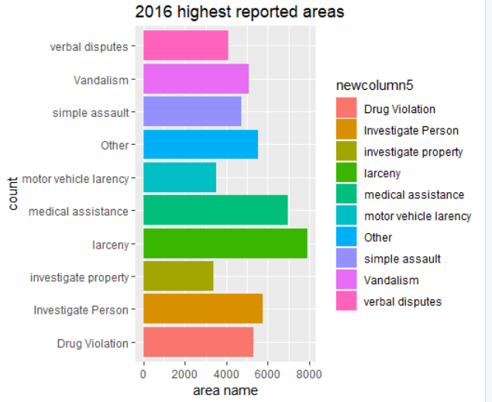
Total 52,256 crimes occured in 2016
Larceny tops the list.

Slide 10
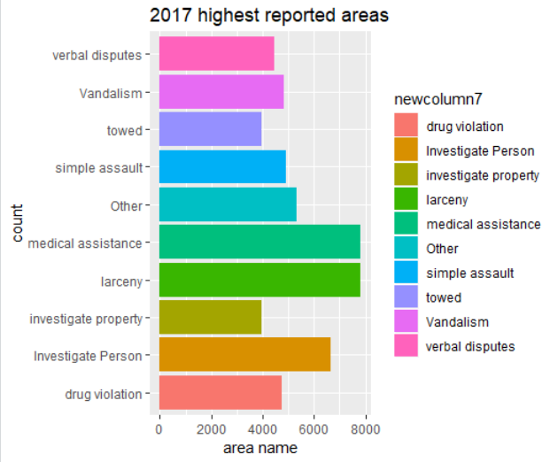
Total 54,469 crimes occured in 2017
Larceny tops the list.
Medical Assistance is the second highest in the list.

Slide 11
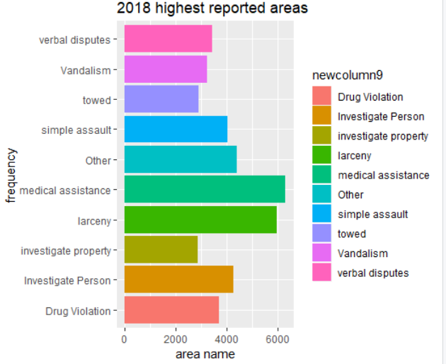
Total 40,946 crimes occured in 2018
Medical assistance tops the list.
Overall, Larceny is the highest occurring crime.

Slide 12
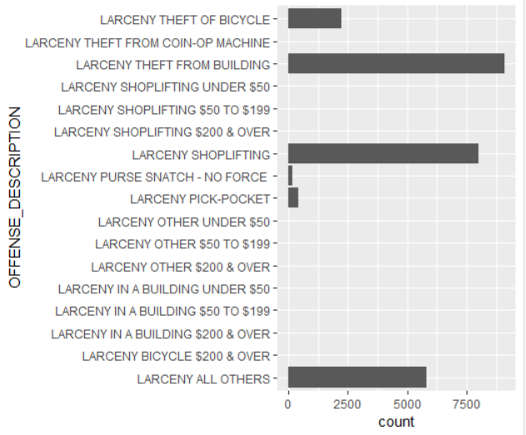
MORE INSIGHTS INTO LARCENY CRIME
---> The highest larceny occuring is the theft from the building
---> Second is the Shoplifting
---> Followed by Theft of Bicycle and purse snatching or pick pocketing.

Slide 13


Slide 14
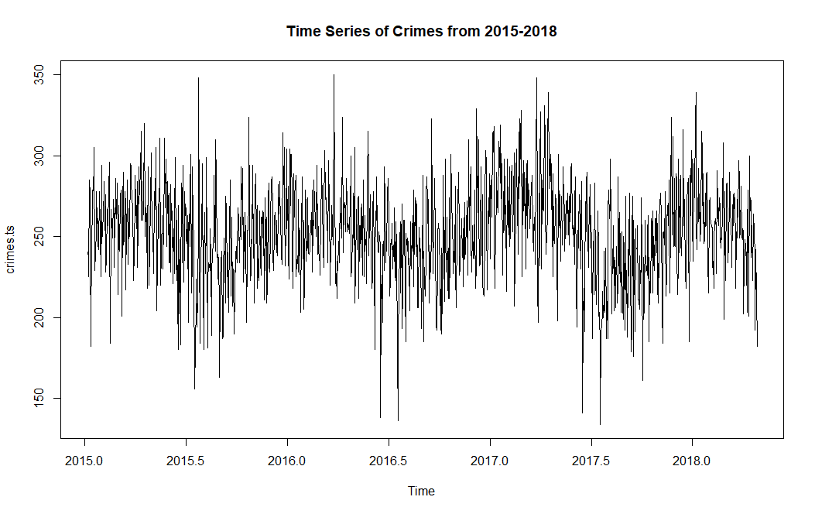
Number of crimes per day from 2015-2018

Slide 15
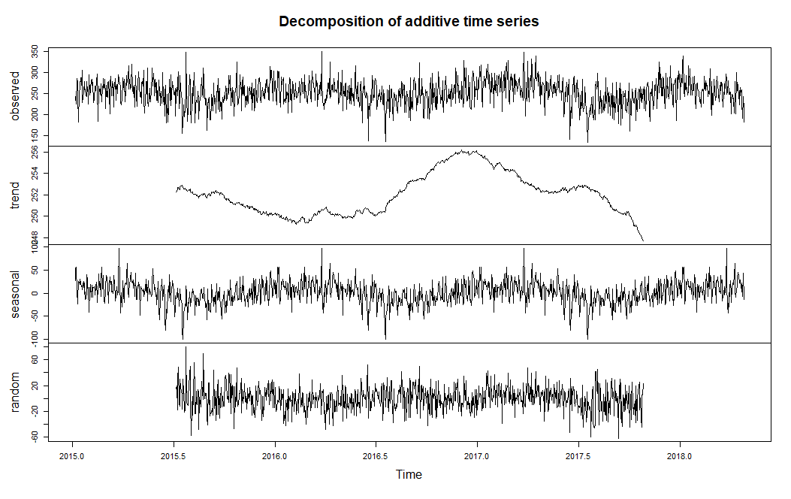

Slide 16

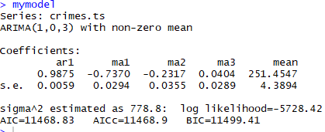

Slide 17
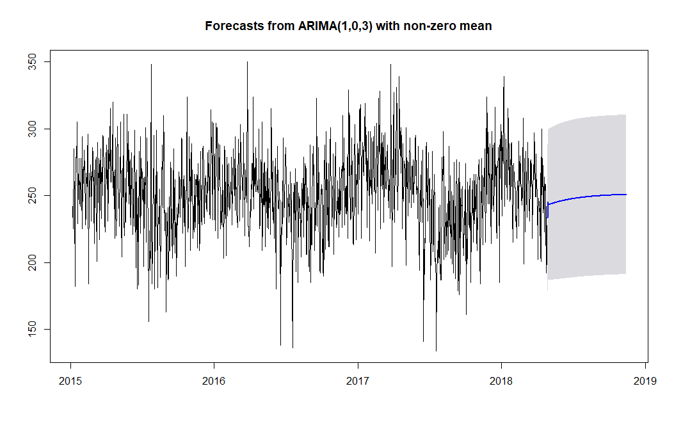

Slide 18


Slide 19

HYPOTHESIS TESTING

Slide 20
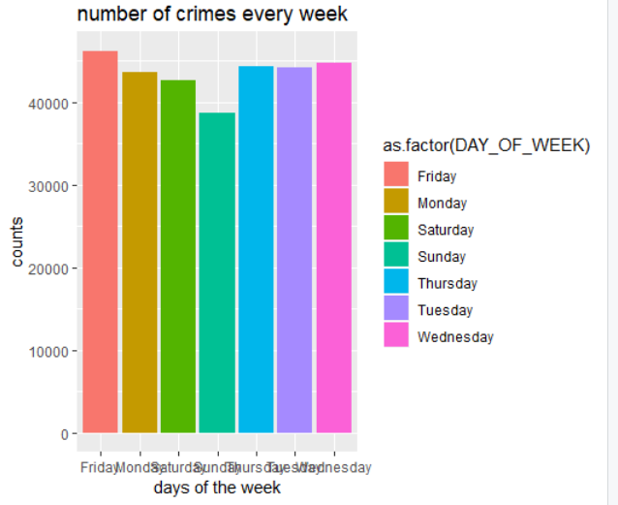


Slide 21


Slide 22


Slide 23
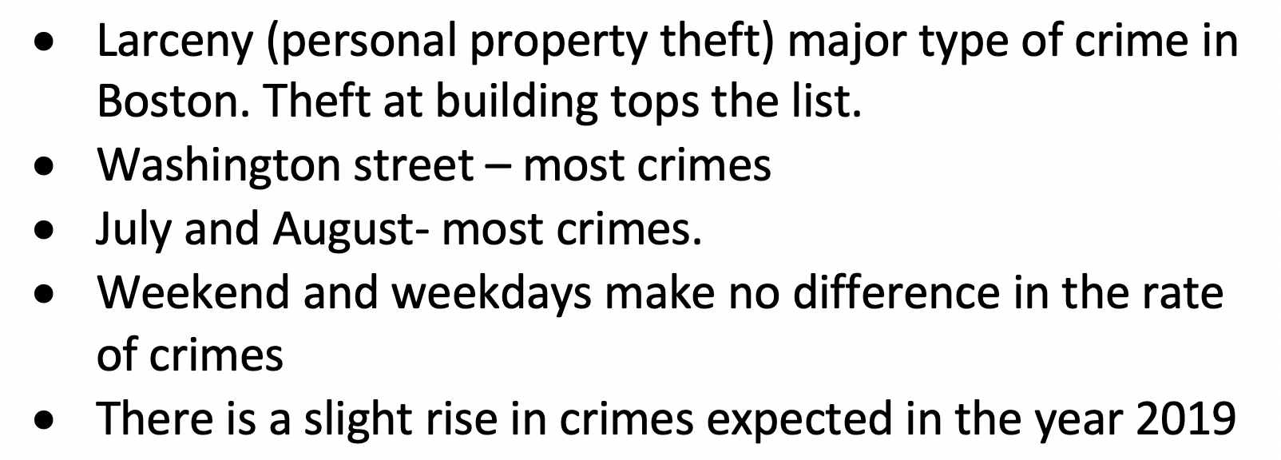
SUMMARY

Slide 24


